Slide 1
COURSE TITLE: Operating Systems
UNIT -1

Slide 2
UNIT 1: Introduction To Operating System

Slide 3
Introduction to OS
An operating system acts as an intermediary between the user of a computer and computer hardware.
The purpose of an operating system is to provide an environment in which a user can execute programs conveniently and efficiently.
The OS helps you to communicate with the computer without knowing how to speak the computer’s language. It is not possible for the user to use any computer or mobile device without having an operating system.

Slide 4
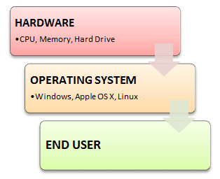
Introduction to OS

Slide 5
Introduction to OS: Its need and operating system services
Purposes of an Operating System
It controls the allocation and use of the computing System’s resources among the various user and tasks.
It provides an interface between the computer hardware and the programmer that simplifies and makes it feasible for coding and debugging of application programs.

Slide 6
Introduction to OS: Its need and operating system services
Structure of a Computer System
A Computer System consists of:
Users (people who are using the computer)
Application Programs (Compilers, Databases, Games, Video player, Browsers, etc.)
System Programs (Shells, Editors, Compilers, etc.)
Operating System ( A special program which acts as an interface between user and hardware )
Hardware ( CPU, Disks, Memory, etc)

Slide 7
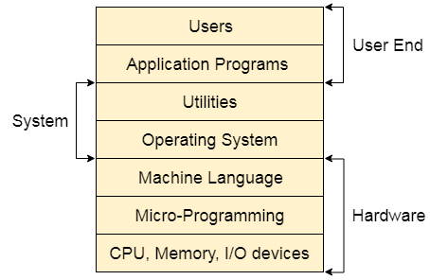
Introduction to OS: Its need and operating system services
Structure of a Computer System

Slide 8
Introduction to OS: Its need and operating system services
Functions of Operating System
Certainly, here are the main functions of an operating system:
Process Management
Memory Management
File System Management
Device Management
User Interface
Security and Access Control
Networking
File and Data Management

Slide 9
Introduction to OS: Its need and operating system services
In an operating system software performs each of the function:
Process Management: The OS manages and schedules processes (programs) running on the computer. It allocates CPU time, memory, and other resources to ensure efficient multitasking and responsiveness.
Memory Management: The OS controls the allocation and deallocation of memory for processes. It maintains a memory hierarchy, which includes main memory (RAM) and secondary storage (hard drives, SSDs), to optimize performance.
File System Management: The OS organizes and manages files on storage devices. It provides file operations such as creation, deletion, reading, and writing, and ensures data integrity and security.

Slide 10
Introduction to OS: Its need and operating system services
Device Management: The OS handles communication with hardware devices like printers, displays, keyboards, and network adapters. It provides device drivers to facilitate interaction between software and hardware.
User Interface: The OS provides a user interface (UI) that allows users to interact with the computer system. This can be a command-line interface (CLI) or a graphical user interface (GUI) with windows, icons, menus, and pointers.
Security and Access Control: The OS enforces security measures to protect the system and user data. It manages user accounts, permissions, and authentication mechanisms to ensure authorized access.

Slide 11
Introduction to OS: Its need and operating system services
Networking: If the computer is part of a network, the OS enables network communication and manages network connections, protocols, and data exchange.
File and Data Management: The OS manages data organization, storage, retrieval, and backup. It ensures data integrity and provides mechanisms for data recovery in case of failures.

Slide 12
Operating system Classification
Types of Operating Systems (OS)
1. Single-User Operating System:
A single-user operating system is designed to be used by only one user at a time.
It's commonly found on personal computers and provides a user-friendly environment for tasks like web browsing, document editing, and entertainment.
A Single-User Operating System is a system in which only one user can access the computer system at a time.

Slide 13
Operating system Classification
1. Single-User Operating System:
The operating system is responsible for handling many different tasks and is typically one of the most important programs used on a computer.
It manages memory usage and other resources, hardware connectivity and the proper execution of other applications.
A single task operating system can only run one program or application at a time. So it is not as useful for a computer or other device intended to run multiple programs at once.

Slide 14
Operating system Classification
1. Single-User Operating System:
The operating system is responsible for handling many different tasks and is typically one of the most important programs used on a computer.
It manages memory usage and other resources, hardware connectivity and the proper execution of other applications.
A single task operating system can only run one program or application at a time. So it is not as useful for a computer or other device intended to run multiple programs at once.

Slide 15
Operating system Classification
1. Single-User Operating System:
Even though this type of operating system can connect to other computers through a network, it is still only being used by a single user.
As long as the computer only has one monitor, keyboard and other input devices, then it is a single-user system.

Slide 16
Operating system Classification
a. Single-User Single-Tasking operating system
In the Single-User Single-Tasking operating system, only one user is permitted for performing a single task at a time. Some functions such as printing a document and downloading images and videos are performed in one given frame.
This operating system is designed especially for wireless phones as well as two-way messaging devices. For example, MS-DOS, Palm OS, etc.

Slide 17
Operating system Classification
b. Single-User Multi-Tasking operating system
Single-User Multi-Tasking operating system is developed especially for one user, but this single user can perform multiple tasks simultaneously.
For example, you can write any text while surfing the internet, downloading images, watching movies, etc., on Windows, Linux, Mac O/S.

Slide 18
Operating system Classification
2. Multi-User Operating System:
In a multiuser operating system, multiple numbers of users can access different resources of a computer at the same time.
The access is provided using a network that consists of various personal computers attached to a mainframe computer system.
A multi-user operating system allows the permission of multiple users for accessing a single machine at a time.
The various personal computers can send and receive information to the mainframe computer system. Thus, the mainframe computer acts as the server and other personal computers act as clients for that server.

Slide 19
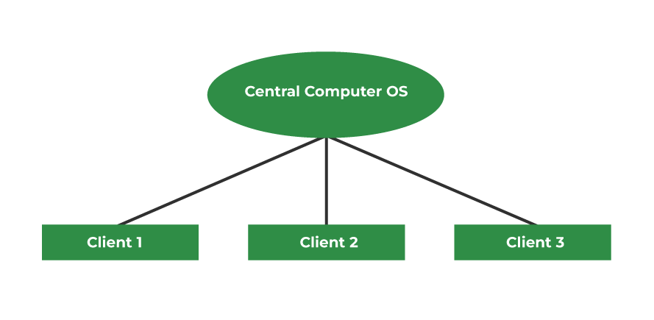
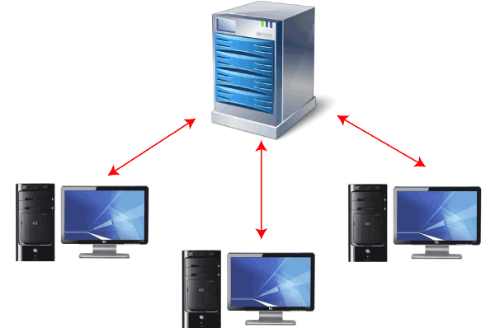
Operating system Classification
2. Multi-User Operating System:

Slide 20
Operating system Classification
2. Multi-User Operating System:
The main goal of developing a multi-user operating system is to use it for time-sharing and batch processing on mainframe systems.
This multi-user operating system is now often used in large organizations, the government sector, educational institutions like large universities, and on servers' side such as Ubuntu Server or Windows Server.
These servers allow several users to access the operating system, kernel, and hardware at the same time.

Slide 21
Operating system Classification
Types of Multi-User Operating System
There are various types of multi-user operating systems. Some of them are as follows:
Distributed System
A distributed system is also known as distributed computing. It is a collection of multiple components distributed over multiple computers that interact, coordinate, and seem like a single coherent system to the end-user.
With the aid of the network, the end-user would be able to interact with or operate them.

Slide 22
Operating system Classification
Types of Multi-User Operating System
There are various types of multi-user operating systems. Some of them are as follows:
Time-Sliced Systems
It's a system in which each user's job gets a specific amount of CPU time. In other words, each work is assigned to a specific time period.
These time slices look too small to the user's eyes. An internal component known as the 'Scheduler' decides to run the next job.
This scheduler determines and executes the job that must perform based on the priority cycle.

Slide 23
Operating system Classification
Types of Multi-User Operating System
There are various types of multi-user operating systems. Some of them are as follows:
Multiprocessor System
Multiple processors are used in this system, which helps to improve overall performance.
If one of the processors in this system fails, the other processor is responsible for completing its assigned task.

Slide 24
Operating system Classification
3. Batch Operating System
This type of operating system does not interact with the computer directly.
There is an operator which takes similar jobs having the same requirement and groups them into batches. It is the responsibility of the operator to sort jobs with similar needs.
In Batch operating system, access is given to more than one person; they submit their respective jobs to the system for the execution.
The system put all of the jobs in a queue on the basis of first come first serve and then executes the jobs one by one. The users collect their respective output when all the jobs get executed.

Slide 25
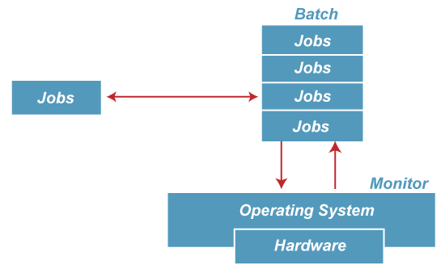
Operating system Classification
3. Batch Operating System

Slide 26
Operating system Classification
Advantages of Batch Operating System
Multiple users can share the batch systems.
The idle time for the batch system is very less.
It is easy to manage large work repeatedly in batch systems.

Slide 27
Operating system Classification
Disadvantages of Batch Operating System
The computer operators should be well known with batch systems.
Batch systems are hard to debug.
It is sometimes costly.
The other jobs will have to wait for an unknown time if any job fails.
Examples of Batch Operating Systems: Payroll Systems, Bank Statements, etc.

Slide 28
Operating system Classification
4. Multi-Programming Operating System
Multiprogramming Operating Systems can be simply illustrated as more than one program is present in the main memory and any one of them can be kept in execution. This is basically used for better execution of resources.
Multiprogramming is an extension to batch processing where the CPU is always kept busy. Each process needs two types of system time: CPU time and IO time.
In a multiprogramming environment, when a process does its I/O, The CPU can start the execution of other processes. Therefore, multiprogramming improves the efficiency of the system.

Slide 29
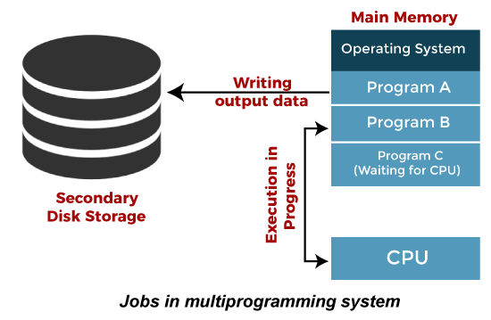
Operating system Classification
4. Multi-Programming Operating System

Slide 30
Operating system Classification
Advantages of Multi-Programming Operating System
Multi Programming increases the Throughput of the System.
It helps in reducing the response time.
Disadvantages of Multi-Programming Operating System
There is not any facility for user interaction of system resources with the system.
Multiprogramming systems provide an environment in which various systems resources are used efficiently, but they do not provide any user interaction with the computer system.

Slide 31
Operating system Classification
6. Multi-Processing Operating System
Multi-Processing Operating System is a type of Operating System in which more than one CPU is used for the execution of resources. It betters the throughput of the System.
In Multiprocessing, Parallel computing is achieved. There are more than one processors present in the system which can execute more than one process at the same time. This will increase the throughput of the system.

Slide 32
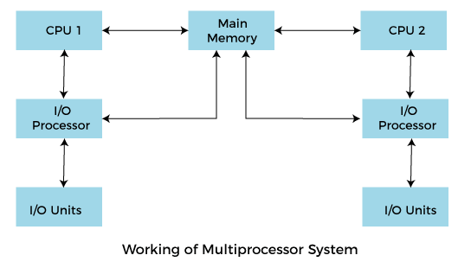
Operating system Classification
6. Multi-Processing Operating System

Slide 33
Operating system Classification
Advantages of Multiprocessing operating system:
Increased reliability: Due to the multiprocessing system, processing tasks can be distributed among several processors. This increases reliability as if one processor fails, the task can be given to another processor for completion.
Increased throughout: As several processors increase, more work can be done in less.
Disadvantages of Multiprocessing operating System
Multiprocessing operating system is more complex and sophisticated as it takes care of multiple CPUs simultaneously.

Slide 34
Operating system Classification
7. Multi-Tasking Operating System
Multitasking Operating System is simply a multiprogramming Operating System with having facility of a Round-Robin Scheduling Algorithm. It can run multiple programs simultaneously.
There are two types of Multi-Tasking Systems which are listed below.
Preemptive Multi-Tasking
Cooperative Multi-Tasking

Slide 35
Operating system Classification
Advantages of Multi-Tasking Operating System
Multiple Programs can be executed simultaneously in Multi-Tasking Operating System.
It comes with proper memory management.
Disadvantages of Multi-Tasking Operating System
The system gets heated in case of heavy programs multiple times.

Slide 36
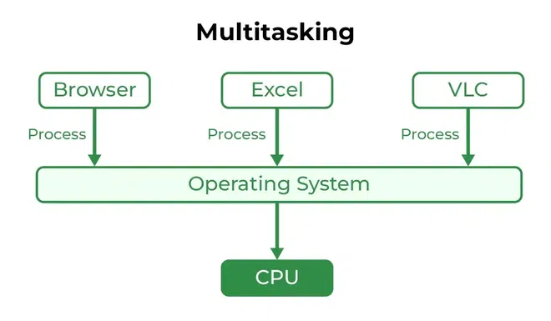
Operating system Classification

Slide 37
Operating system Classification
8. Time-Sharing Operating System
In the Time Sharing operating system, computer resources are allocated in a time-dependent fashion to several programs simultaneously.
Thus it helps to provide a large number of user's direct access to the main computer. It is a logical extension of multiprogramming.
In time-sharing, the CPU is switched among multiple programs given by different users on a scheduled basis.

Slide 38
Operating system Classification
Advantages of Time Sharing Operating System
The time-sharing operating system provides effective utilization and sharing of resources.
This system reduces CPU idle and response time.
Disadvantages of Time Sharing Operating System
Data transmission rates are very high in comparison to other methods.
Security and integrity of user programs loaded in memory and data need to be maintained as many users access the system at the same time.

Slide 39
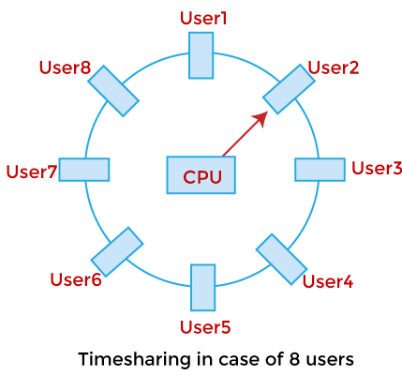
Operating system Classification
Time Sharing Operating System

Slide 40
Operating system Classification
9. Distributed Operating System
The Distributed Operating system is not installed on a single machine, it is divided into parts, and these parts are loaded on different machines.
A part of the distributed Operating system is installed on each machine to make their communication possible.
Distributed Operating systems are much more complex, large, and sophisticated than Network operating systems because they also have to take care of varying networking protocols.

Slide 41
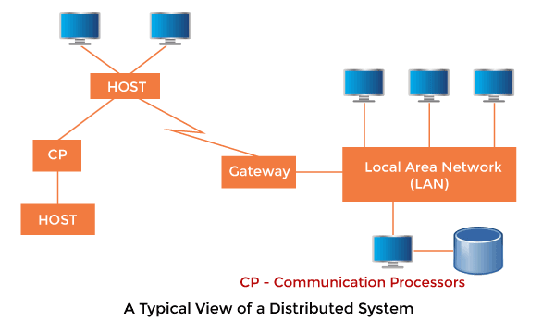
Operating system Classification
Distributed Operating System

Slide 42
Operating system Classification
Advantages of Distributed Operating System
The distributed operating system provides sharing of resources.
This type of system is fault-tolerant.
Disadvantages of Distributed Operating System
Protocol overhead can dominate computation cost.

Slide 43
Operating system Classification
10. Real Time Operating System
In Real-Time Systems, each job carries a certain deadline within which the job is supposed to be completed, otherwise, the huge loss will be there, or even if the result is produced, it will be completely useless.
The Application of a Real-Time system exists in the case of military applications, if you want to drop a missile, then the missile is supposed to be dropped with a certain precision.

Slide 44
Operating system Classification
Advantages of Real-time operating system:
Easy to layout, develop and execute real-time applications under the real-time operating system.
In a Real-time operating system, the maximum utilization of devices and systems.
Disadvantages of Real-time operating system:
Real-time operating systems are very costly to develop.
Real-time operating systems are very complex and can consume critical CPU cycles.

Slide 45
Operating system Classification
Advantages of Real-time operating system:
Easy to layout, develop and execute real-time applications under the real-time operating system.
In a Real-time operating system, the maximum utilization of devices and systems.
Disadvantages of Real-time operating system:
Real-time operating systems are very costly to develop.
Real-time operating systems are very complex and can consume critical CPU cycles.

Slide 46
Operating system Classification
11. Parallel Operating Systems
Parallel operating systems are a type of computer processing platform that breaks large tasks into smaller pieces that are done at the same time in different places and by different mechanisms.
They are sometimes also described as “multi-core” processors.
This type of system is usually very efficient at handling very large files and complex numerical codes.

Slide 47
Operating system Classification
11. Parallel Operating Systems
Parallel Systems are designed to speed up the execution of programs by dividing the programs into multiple fragments and processing these fragments at the same time.

